Slide 1
Introduction to Data Pipelines
Romit Girdhar
Romit.Girdhar@Microsoft.com
Software Engineer - TED

Slide 2
Why do we need Data Pipelines?
Whether you’re developing a Bot, a web application or an IoT application, data is an inevitable part of any modern-day applications.
A application developer and data developer roles are now the fulfilled by the same person.
Partners and customers are all looking to make their applications smarter.

Slide 3
Customers are looking to derive more and more value from data…
EXAMPLES
Sales and marketing
Finance and risk
Customer and channel
Operational Excellence
Sales forecasting
Fraud detection
User segmentation
Agent allocation
Demand forecasting
Risk management
Personalized offers
Usage optimization
Sales lead scoring
Actuarial modeling
Product recommendation
Operational telemetry
Predict customer churn
Enhanced Customer Service
Predictive maintenance
Supply chain optimization
Notes:
With an increase in data….people are trying to do a lot more with their data

Slide 4
Databases – Basics
Table: A logical way to store your data in a Database in a relational (columnar) format.
Schema: A container/structure that represents a logical view of the database. Constraints and relationships are applied on the data within it.
Views: A different lens to view the data stored in your tables. Views do not store any data.
Stored Procedure: Similar to a method or function in a programming language.
Trigger: As the name suggests, it triggers the execution of a function/Stored Procedure.

Slide 5
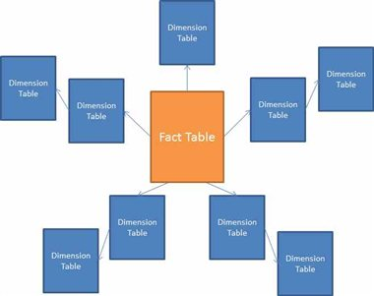
Data Pipelines & Staging made easier
Fact Tables
Consists of facts and metrics
Eg: Transactional data
Dimensions
Contains ‘metadata’ or measures about the facts
Has a foreign key relationship to the fact tables
Star Schema
Special case of the Snowflake schema
Consists of Facts & Dimension tables
Snowflake Schema
Schema that is Normalized to 3NF
Also tend to contain relationship between dimension tables
Notes:
James

Slide 6
Star Schema
Notes:
James

Slide 7
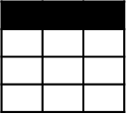


Evolving approaches to analytics
EXTRACT
TRANSFORM
LOAD
OLTP, ERP, LOB, ...
Original data
Transformed data
BI tools
ETL tool
EDW
(SSIS, etc.)
(SQL Sever, Teradata, etc.)
Data marts
(On-premise and in the cloud)
INGEST
TRANSFORM AND LOAD
Dashboards
Devices, social, sensors, web
Original data
Scale-out, storage, and compute
Apps
(HDFS, Blob storage, etc.)
Notes:
Going from ETL to ELT
Number and types of sources and sinks are changing
Talk about why we need different OLTP and OLAP stores/engines

Slide 8



Lambda Architecture – Detailed View
Event Decoration
Event Processing Logic
Dashboards/Reports
Hot
Store
Inbound
Data
Buffered
Ingestion
(message bus)
Spooling/Archiving
Exploration
Curation
Analytical
Store
Data Movement
/ Sync
Interactive
Serving and
Consumption

Slide 9
Lambda Architecture – Detailed View
Event Decoration
Event Processing Logic
Dashboards/Reports
Hot
Store
Inbound
Data
Buffered
Ingestion
(message bus)
Spooling/Archiving
Exploration
Curation
Analytical
Store
Data Movement
/ Sync
Interactive
Ingestion
Processing
Staging
Serving and
Consumption

Slide 10




Ingestion
Processing
Staging
Serving
Enrichment and Curation
Modern Data Lifecycle

Slide 11
Ingestion
Processing
Staging
Serving
ADLS
Azure DW
Azure SQL DB
Hbase
Cassandra
Azure Storage
Power BI
Event Hubs
IoT Hubs
Service Bus
Kafka
HDInsight
ADLA
Storm
Spark
Stream Analytics
ADLS
Azure Storage
Azure SQL DB
Enrichment and Curation
Azure Data Factory
Azure ML
Modern Data Lifecycle

Slide 12
Ingestion
Processing
Staging
Serving
Event Hubs
IoT Hubs
Service Bus
Kafka
Enrichment and Curation
Modern Data Lifecycle

Slide 13

Ingestion
Data pushed to a broker for further processing
Typically indicative of streaming approaches.
Best alignment with many existing systems.
Use scheduled jobs to synchronize or move data.
Typical “batch” processing.
Data pushed to storage for further processing

Slide 14
Azure Ingestion Options
IoT Hub
Bi-Directional Communication
Event Hub
Device to cloud mass ingestion
Service Bus
Complex filters and processing rules
Kafka
Common OSS integration

Slide 15
Ingestion
Processing
Staging
Serving
Stream Analytics
Storm
Spark Streaming
Enrichment and Curation
Modern Data Lifecycle

Slide 16

Hot Path Processing
Must think about the end use:
Indexing for operational dashboards
Transformation/Curation for persistence
Spooling to an alternate store
Multiple processing ”instances” can work off of the broker.

Slide 17

Azure Stream Analytics End-to-End Architecture Overview
Temporal Semantics
Guaranteed delivery
Guaranteed up time
Outputs
SQL Azure
Azure Blobs
Event Hub
ADLS
PowerBI
…
Transform
Temporal joins
Filter
Aggregates
Projections
Windows
Etc.
Enrich
Correlate

Event Inputs
Event Hub
IoT Hub
Azure Blob
BI Dashboards
Predictive Analytics

Reference Data
Azure Blob
Azure SQL DB
☁
Azure
Storage

Slide 18
Ingestion
Processing
Staging
Serving
HDInsight
ADLA
Spark
ADLS
Azure Storage
Azure SQL DB
Enrichment and Curation
Modern Data Lifecycle

Slide 19
Cold Path Processing
Multiple processing ”instances” can work on top of dis-aggregated storage
Lot’s of options abound depending on the need:
Relational engines
Big Data solutions / in-mem or not
Other

Slide 20




Azure Data Lake
Analytics Service
HDInsight
Partners
Integrated analytics and storage
Fully managed
Easy to use–“dial for scale”
Proven at scale
Analyze data of any size, shape or speed
Open-standards based
U-SQL
YARN
HDFS
Store
Applications
Devices
Sensors
Social
Relational
Web
Clickstream
Video

Slide 21
Ingestion
Processing
Staging
Serving
Enrichment and Curation
Azure Data Factory
Azure ML
Modern Data Lifecycle

Slide 22
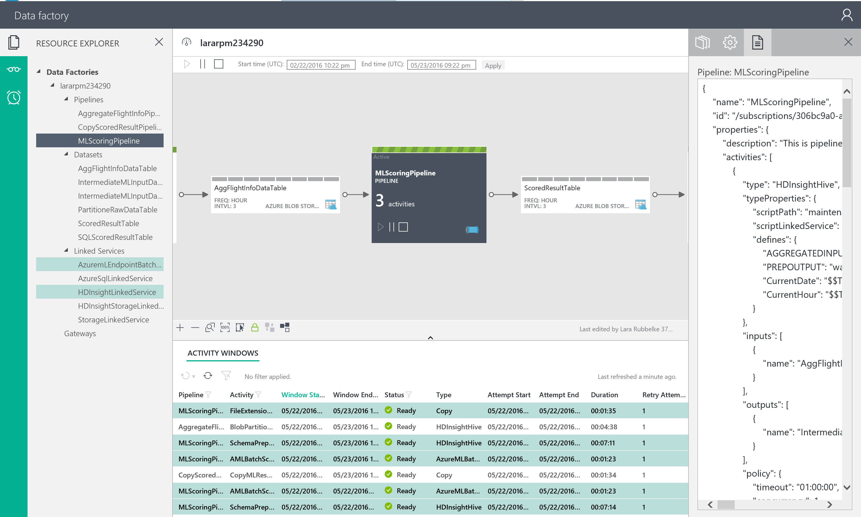
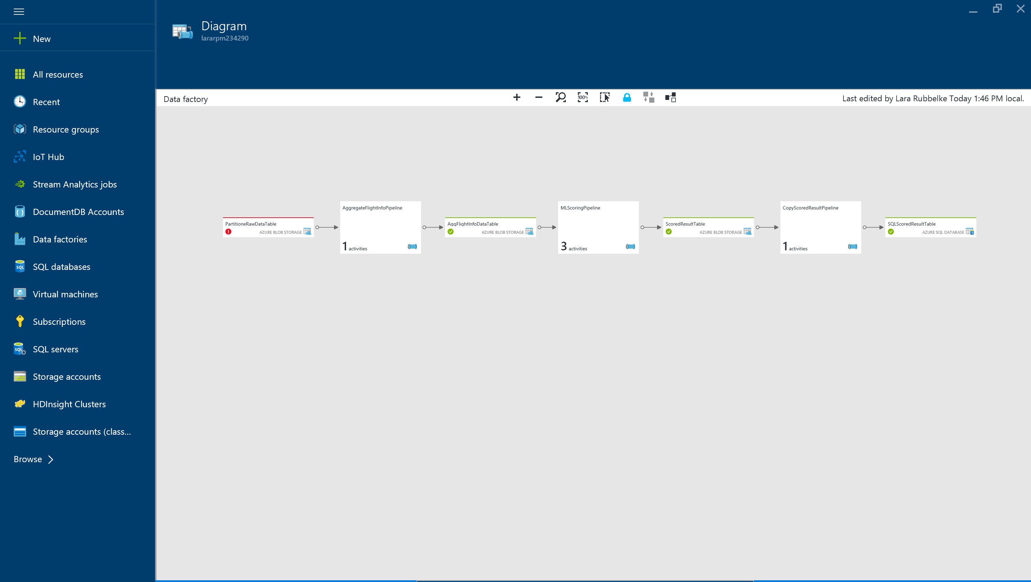
Azure Data Factory

Slide 23
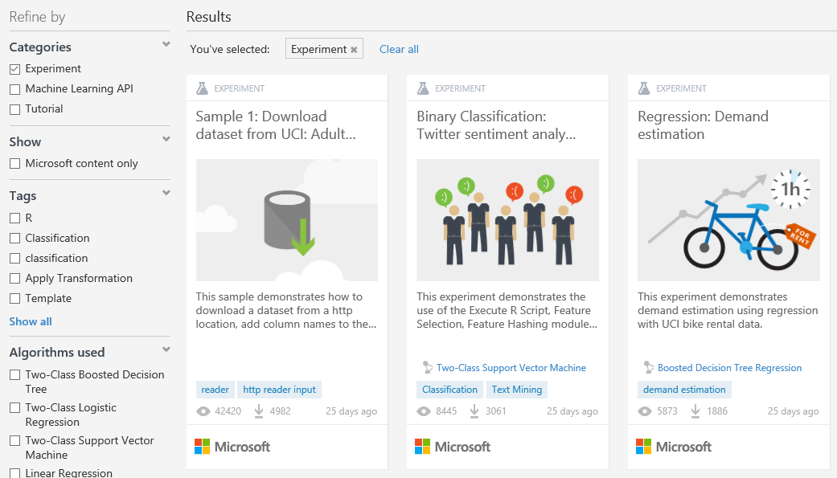
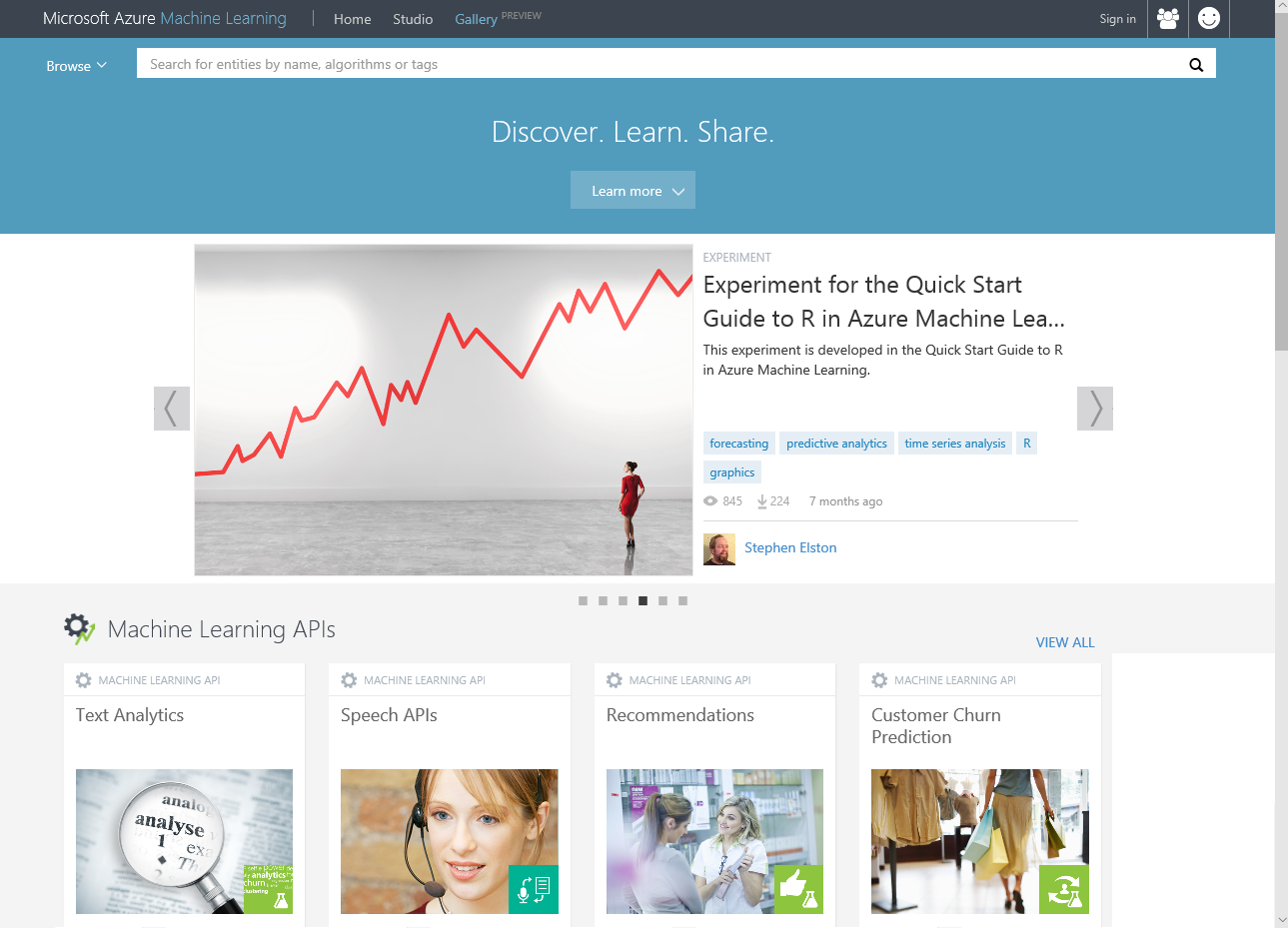
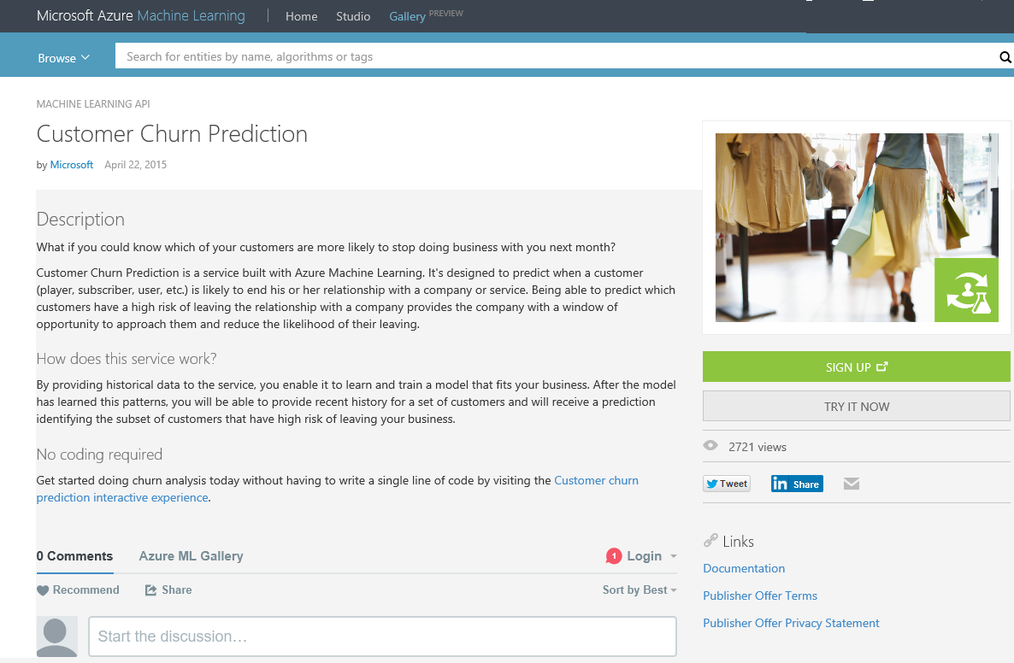

Slide 24
Ingestion
Processing
Staging
Serving
ADLS
Azure DW
Azure SQL DB
Hbase
Cassandra
Azure Storage
Power BI
Enrichment and Curation
Azure Data Factory
Azure ML
Modern Data Lifecycle

Slide 25
Dashboards
Interactive
Exploration
Serving

Slide 26

Serving
Typically serving here is constrained:
Constrained on particular access patterns
Constrained on dashboard scenarios
Serving here optimized for reducing “observation latency”
Typically serving here can be unconstrained
Still used for dashboards
Used for data exploration and ML
Used for interactive BI
Often used for broad sharing

Slide 27



Azure Data Lake and SQLDW
Unknown Value Data
XML
High Value Data
JSON
TEXT
Set-based
Load
Transform
Model
Aggregate
Consume
Procedural
Pre-process
Transpose
Re-format
Batch
Ad-hoc
Batch

Slide 28
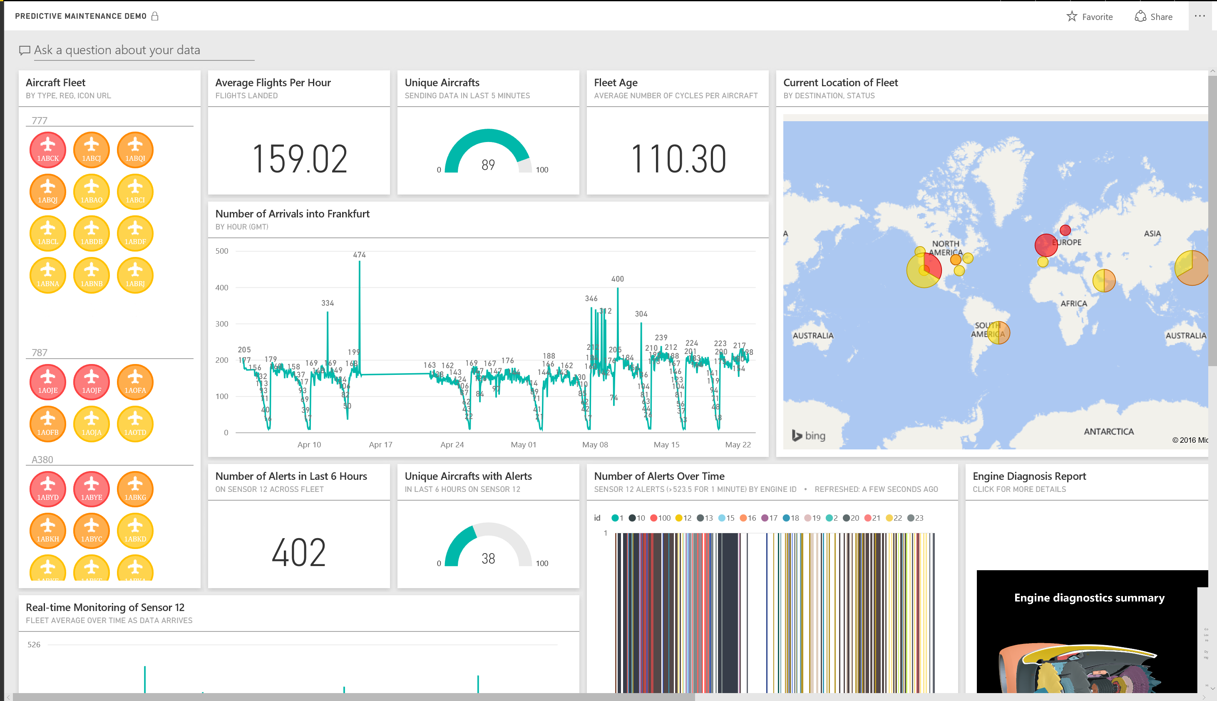
Power BI & Power BI Embedded

Slide 29
Ingestion
Processing
Staging
Serving
ADLS
Azure DW
Azure SQL DB
Hbase
Cassandra
Azure Storage
Power BI
Event Hubs
IoT Hubs
Service Bus
Kafka
HDInsight
ADLA
Storm
Spark
Stream Analytics
ADLS
Azure Storage
Azure SQL DB
Enrichment and Curation
Azure Data Factory
Azure ML
Modern Data Lifecycle

Slide 30
Lambda Architecture – Bringing it all together
Event Decoration
Event Processing Logic
Dashboards/Reports
Hot
Store
Inbound
Data
Buffered
Ingestion
(message bus)
Spooling/Archiving
Exploration
Curation
Analytical
Store
Data Movement
/ Sync
Interactive
Ingestion
Processing
Staging
Serving and
Consumption

Slide 31
Introduction to the Data Lab
E-commerce web store Scenario.
Four Modules
Module 1: Ingestion & Hot-path processing
Module 2: Processing & Staging
Module 3: Security Best Practices
Module 4: Consumption of your Data Pipeline

Slide 32
Background & Scenario
E-commerce website called ‘PartsUnlimited’
Known for selling Automobile (car) parts.
The Leadership at Partsunlimited Inc. wants to get a detailed view of how their business is doing on a daily basis & make their website smarter by adding Recommendations & bot support.
They’d like the help of Microsoft Azure to help them make better business decisions.

Slide 33
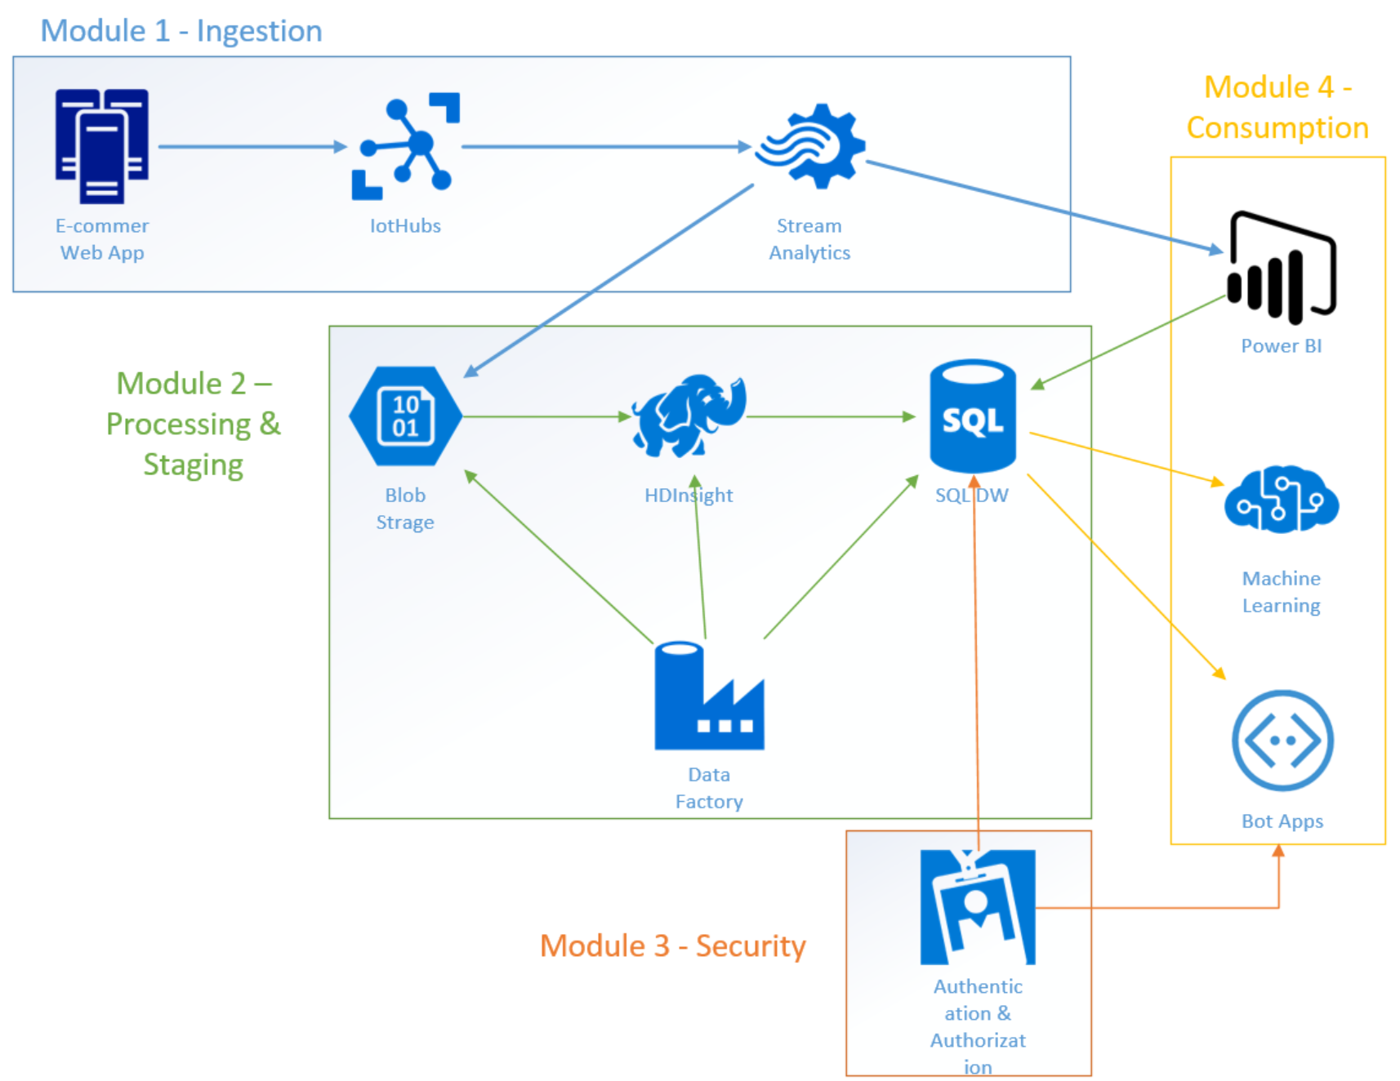
Data Lab – Architecture

Slide 34
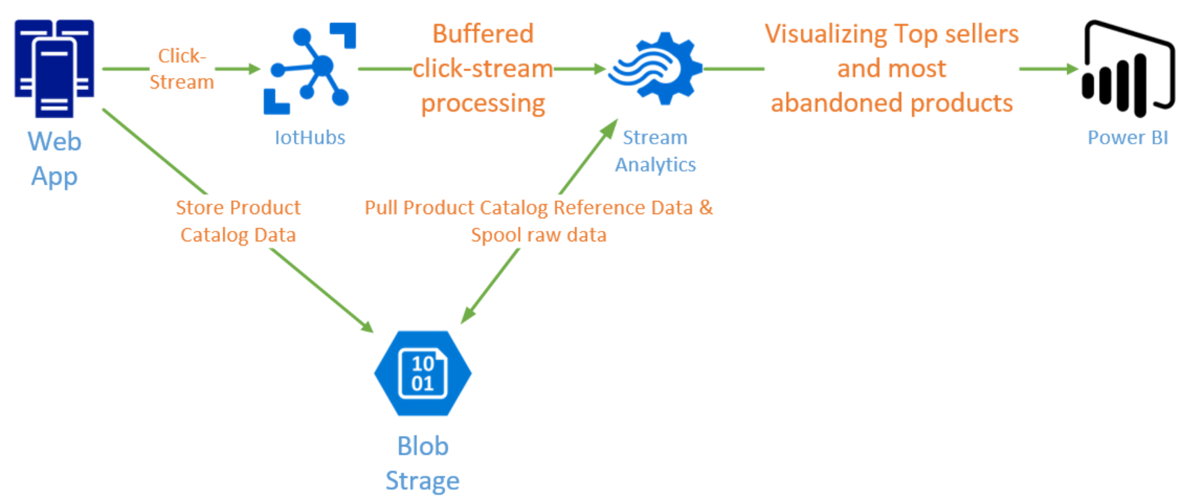
Module 1 – Ingestion – Architecture

Slide 35
Module 1 – Ingestion - Overview
The website has recently been modified to use the IoTHubs SDK to stream click data to Microsoft Azure as it happens. We will mimic this click stream data using a C# console application.
We will use DocumentDB (NoSQL) to store our IoTHubs device data.
Th click stream includes data on product-interactions such as which products are being viewed, bought, etc.

Slide 36
Module 1 – Ingestion - Overview
We will be using Azure Stream Analytics to process the data in Near-real time and understand which products are top-selling.
We will also use Stream Analytics to understand which products are added to carts, but not bought. This will help the Partsunlimited Leadership team understand which products are not competitively priced.
We will use Power BI to serve this data in the form of charts and reports.

Slide 37
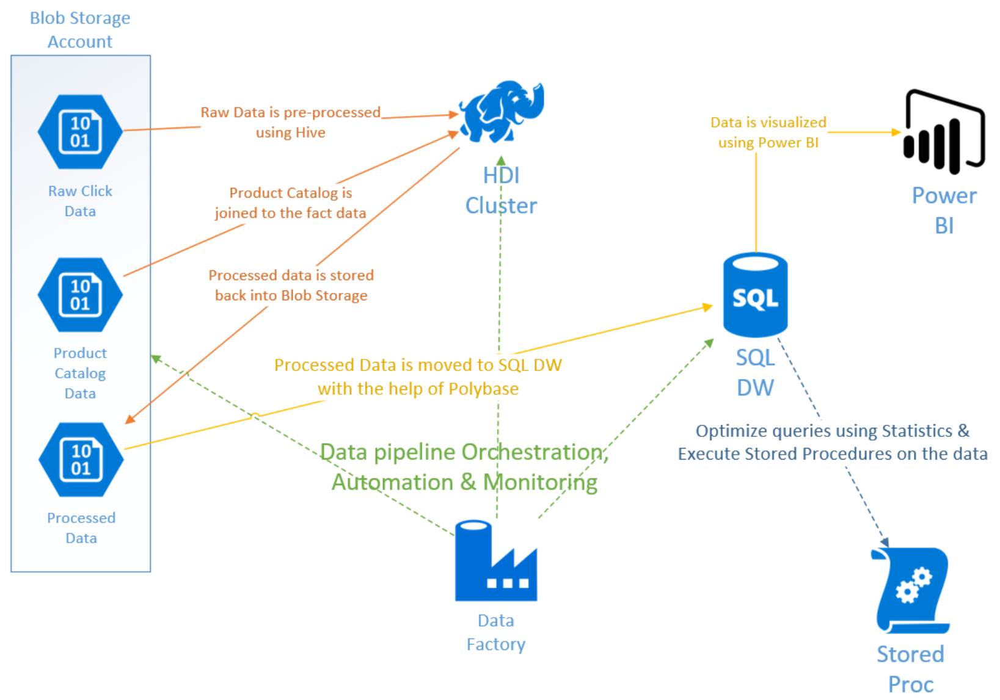
Module 2 – Architecture

Slide 38
Module 2 – Processing & Staging - Overview
Not all processing can be performed in Near-real time. Companies find it very useful to compute longer-term trends on their data to understand patterns.
Since there is a lot of NoSQL data being generated, we used Blob Storage to store the data for longer term processing.
We will demonstrate using HDInsight (Hadoop on Azure) to pre-process our data & parse the JSON files and provide structure to the data. We will also use HDInsight to perform complex queries that can easily be performed in a NoSQL engine like Hadoop.

Slide 39
Module 2 – Processing & Staging - Overview
We will then move our data into a Processing & Staging environment, which is SQL Data Warehouse
We will store our high-valued data into the SQL Data Warehouse and use the power of Distributed computing to perform aggregations on our data. This will include execution of a Stored Procedure.
We will demonstrate how to compute Statistics on your data and how that helps SQL Data Warehouse optimize your queries.

Slide 40
Module 2 – Processing & Staging - Overview
Finally, we will use Azure Data Factory for the end-to-end orchestration and automation of our data pipeline.
We will demonstrate how to monitor your pipelines using Azure Data Factory.
We will use Power BI to consume our data and create interactive reports and dashboard.

Slide 41
Module 3 – Security - Overview
Partsunlimited is a multi-tenant company that has different vendors selling different types of products on its website.
These vendors require access to this new data model. However, Partsunlimited would like to give the vendors access to only the data that pertains to them.
Partsunlimited also has some compliance requirements around encryption of data at rest, which needs to be addressed.

Slide 42
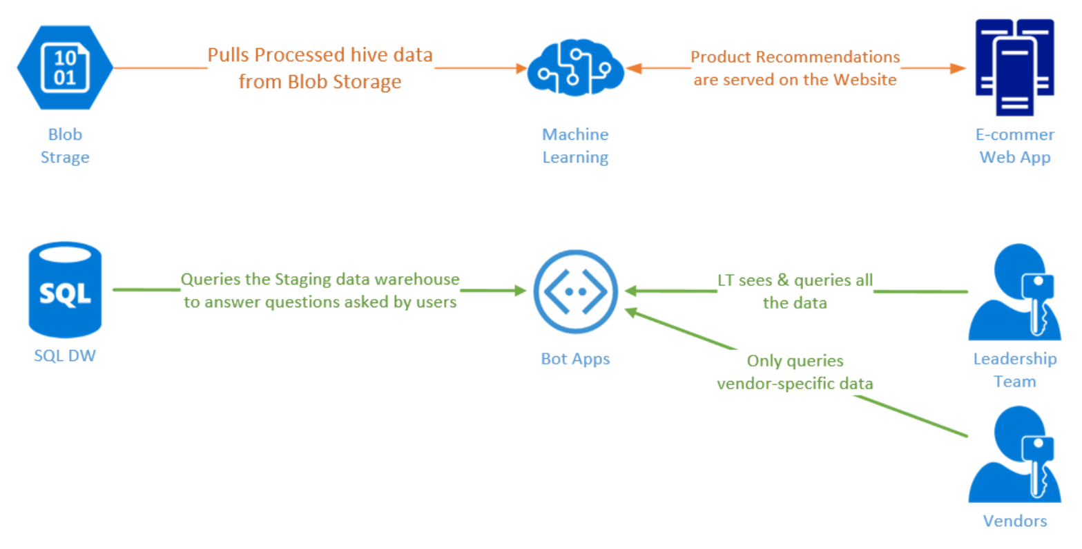
Module 4 – Consumption - Architecture

Slide 43
Module 4 – Consumption - Overview
Now that we have created a robust data pipelines, it is time to use this pipeline to make PartsUnlimited a smarter application.
We have already demonstrated the consumption of this data via Power BI to provide statistical insights into the user-behavior and usage of the web store.
We will be demonstrating how to connect to and consume your data via a bot.
We will also be using our Data pipelines to power our Product Recommendations engine & display recommendations our website, thus making our e-store smarter.

Slide 44
Storage Options
*
*Note: SQL Data Warehouse is also a compute engine, even though it is shown as a part of the Storage options

Slide 45
Compute Options

